Slide 1
It Starts With Us: Moving Toward a Trauma-Informed Understanding of How Our Work Can Affect Us
Notes:
Estimated Module Time: 90 minutes
(Depending on the amount of discussion time and selected interactive activities)
Training Outline
Learning objectives
Secondary traumatic stress
Strategies for primary care providers
Self-Care and Relationship Checklist
Organizational self-assessment tool
Overview
Working with patients who experience trauma can affect the caregiver/service provider, creating secondary traumatic stress. This module reviews self-care strategies for caregivers and policies that providers can utilize.

Slide 2
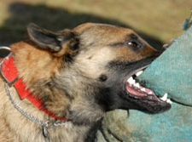
What is Trauma?
An experience that is overwhelming for that person.
Trauma might look different for you or me, but we’ve all experienced it at some level.
Notes:
Notes to Trainer: Whether its family violence or something else the benefit of coming from an universal framework is that, it’s not an us versus them or you versus me, but rather an all of us issue. It doesn’t leave anyone out. It doesn’t shame anyone.

Slide 3
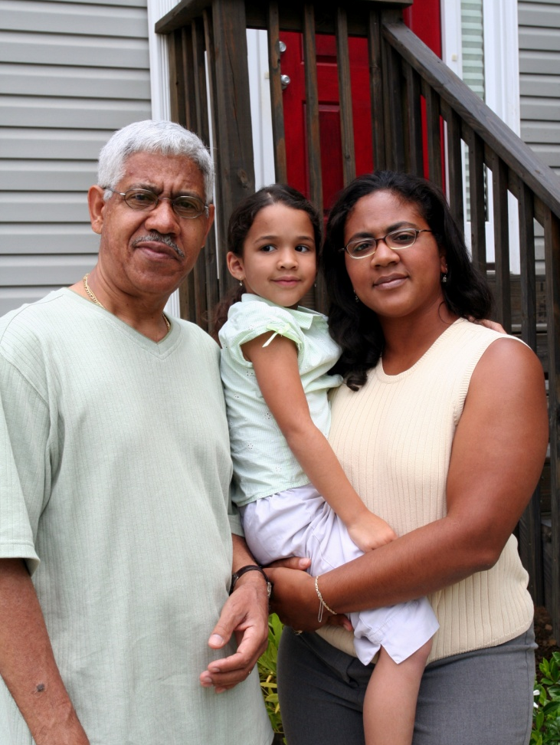
Reflecting on Trauma
Historical, Cultural and Intergenerational
Cultural trauma: an attack on the fabric of a society, affecting the essence of the community and its members
Historical trauma: cumulative exposure of traumatic events that affect an individual and continue to affect subsequent generations
Intergenerational trauma: when trauma is not resolved, subsequently internalized, and passed from one generation to the next.
(D.S. BigFoot, 2007 ©)
Notes:
Notes to Trainer: What is our goal here? Our goal is to recognize that trauma goes beyond the car crash or witnessing violence. Trauma can be historical, cultural and intergenerational, too.
Optional exercise: Ask participants to give examples of cultural (example: 9/11), historical (Jews and the holocaust, American Indians and colonization, African Americans and slavery, etc.), and intergenerational trauma (cycle of abuse repeated). Ideally as we become more trauma informed, we have an opportunity to examine our personal beliefs and assumptions about how other kinds of trauma may affect our clients:
A process of connecting our histories with our current selves
An awareness of how values, biases, cultural background, regional perspectives, personal history, and beliefs impact our work with children and parents.
The process of opening up space for emotional and intellectual exploration
http://www.isu.edu/irh/projects/ysp/downloads/CulturalIssuesinHistoricalTrauma.pdf

Slide 4
Close your eyes. Think of a time when you felt helpless. What was going on in your body at that time?
Body temp changes
Smells heightened
Feel unpleasant sensations (nauseated, dizzy, lightheaded, not enough air in the room, “I got to get out of here”)
Notes:
Notes to Trainer: Ask the audience to think about a time when they felt helpless –not hugely helpless, something smaller but still with impact. They locked their keys in a car during a snowstorm. They lost their child for 5 minutes in a grocery store. Their cell phone died at the worst possible moment and they didn't have a charger.
Ask participants to take themselves back to that moment with their eyes closed. How did they feel? What did they smell? How fast were their hearts beating? What else physiologically went on with them at that time? Then ask them to open their eyes.
Ask participants, beyond this list were there other things that they noticed going on within themselves? For some of them, they may have disassociated, climbed out of their bodies and watched from above. There is a physiological response that occurs. It happens to all of us.

Slide 5
Grounding Exercise To Promote Resiliency
Resiliency Skills – bring yourself back into your body.
Sit up in you chair—plant your feet firmly on the ground.
If comfortable, close your eyes.
Place your hands on your shoulders.
Take a deep breath in as you raise your hands extending in the air and hold for a count of four.
Drop hands back to your shoulders as you exhale.
(Levine & Mate, 2010; Levine 1997)
Notes:
Notes to Trainer: Given that we just took you to a time when you were upset, some of those physical reactions are being repeated inside of you. This exercise is about showing you how you can help yourself and a tool that you can teach to your clients as well.
If participants can’t do the exercise, have them hold themselves tight and rub their arms. Both of these exercises, back against the wall or rubbing arms and hugging self, can help stop you from disassociating.
In an Unspoken Voice: How the Body Releases Trauma and Restores Goodness by Peter Levine and Gabor Mate, 2010
"Waking the Tiger: Healing Trauma - The Innate Capacity to Transform Overwhelming Experiences" by Peter A. Levine 1997

Slide 6
“If we are to do our work with suffering people and environments in a sustainable way, we must understand how our work affects us.”
Laura Van Dernoot Lipsky, 2008
(quote from Trauma Stewardship)
Notes:
Estimated Activity Time: 2 minutes
Notes to Trainer: Ask someone in the audience to read quote on slide. Ask the audience if they think this is important and why.
Catherine Burns, PHD Vicarious Trauma for Behavior Interventionists and Clinicians, 2010

Slide 7
What is Vicarious Trauma?
Vicarious trauma is a change in one’s thinking [world view] due to exposure to other people’s traumatic stories.
(Dr. David Berceli, 2005)
Notes:
Notes to Trainer: Read the definition aloud.
Vicarious traumatization (VT) is a self-transformation of a trauma worker or helper that results from empathic engagement with traumatized clients and their reports of traumatic experiences. Its hallmark is disrupted spirituality, or a disruption in the trauma workers' perceived meaning and hope.
Secondary traumatic stress, also referred to as vicarious trauma, burnout, and compassion fatigue, describes how caring for trauma survivors can have a negative impact on service providers.
This is not a judgment, but a reality of the job.

Slide 8
Personal Exposures to Violence and Secondary Traumatic Stress are Connected
Lifetime exposure to violence is common
Working with clients who are experiencing or have experienced violence can trigger painful memories and trauma
Personal history of exposure to violence increases risk for experiencing secondary traumatic stress

Slide 9
What are common reactions to caring for survivors of trauma?
Notes:
Notes to Trainer: Use an easel to record the audience's comments and fill in the missing thinking with a review of the next slide while only focusing on KEY issues that were missed.

Slide 10
Common Reactions to Caring for Survivors of Trauma
Fear
Helplessness
Sleep disruptions
Depressive symptoms
Feeling ineffective with clients
Recurrent thoughts of threatening situations
Reacting negatively to clients
Thinking of quitting clinical [contact with clients] work
Chronic suspicion of others

Slide 11
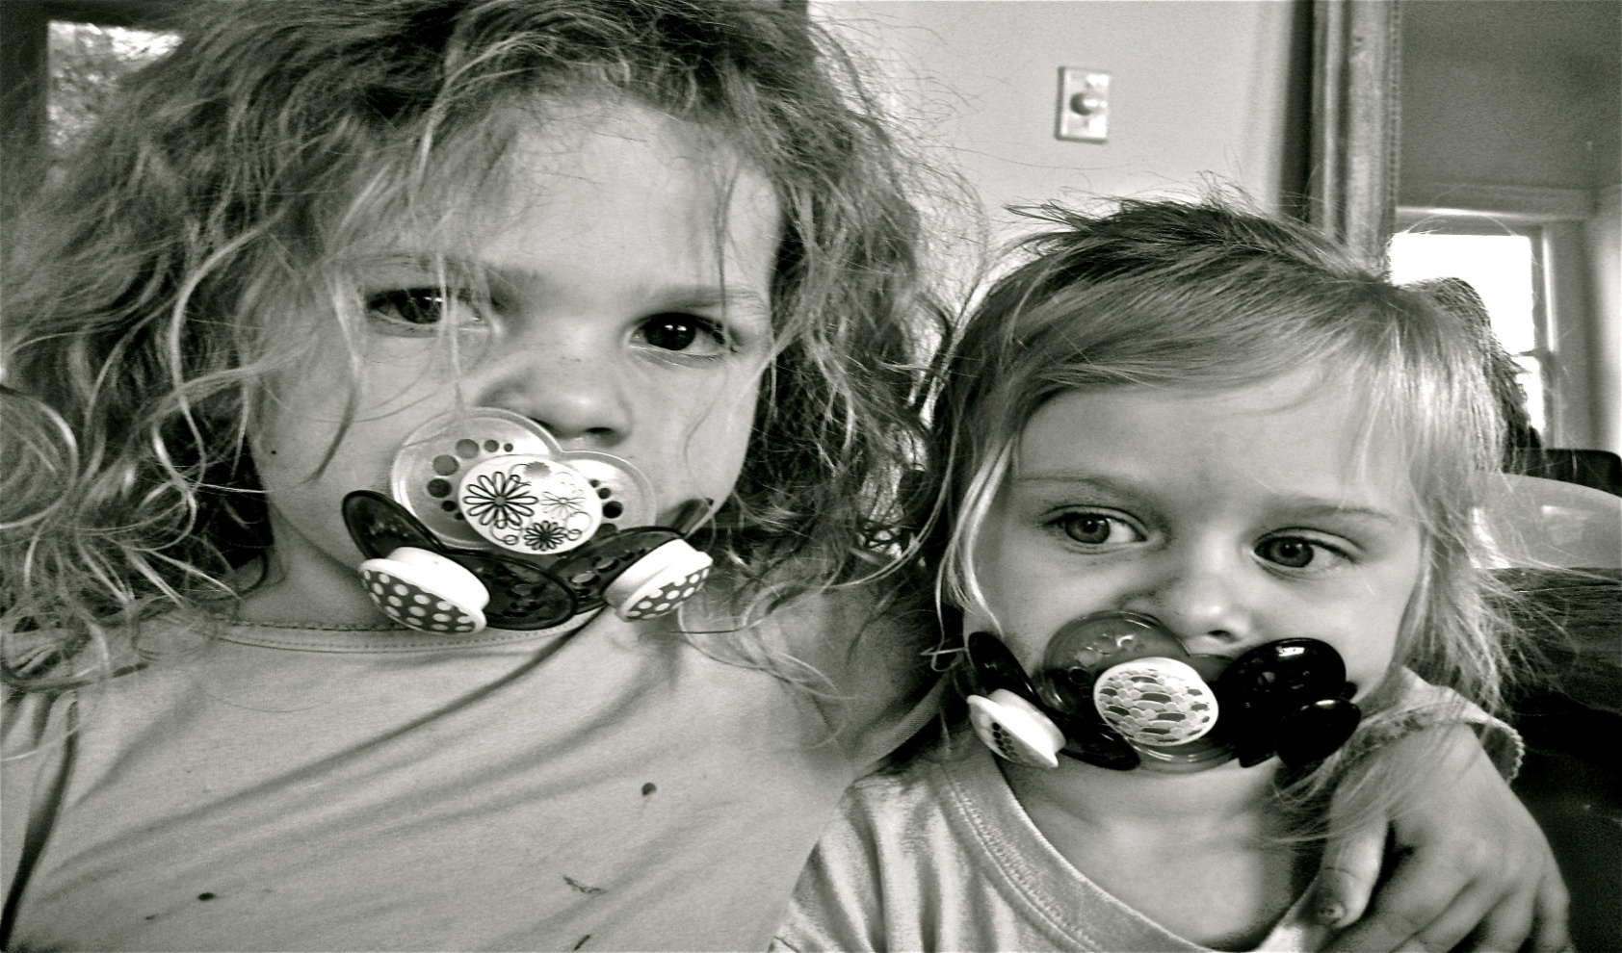
How many of you actively take extra care of yourselves when it comes to this work?
On a scale of 1 (Not at all) to 5 (Routinely)
Notes:
Notes to Trainer: Funny image of two little girls who were weaned off their binkies and found the stash when their mommy wasn’t looking. Why have one when three is better?

Slide 12
This is what works for me, don’t judge.
Notes:
Estimated Activity Time: 5 minutes
Notes to Trainer: Ask participants, how is vicarious trauma manifested? Some answers that may be brought up include:
Comfort Food (For example: French Fries)
Boundary Violation and Transference
Chronic lateness
Taking excessive responsibility for the client
Use of Alcohol and Drugs
Physical symptoms
Inability to relax or enjoy pleasurable activities
Anger
Reacting angrily to clients/staff/colleagues
Feelings of guilt
Detachment
Avoiding clients

Slide 13
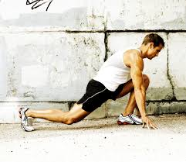
What Works for You?
Notes:
Estimated Activity Time: 5 minutes
Notes to Trainer: Ask participants, how is vicarious trauma manifested? Some answers that may be brought up include:
Comfort Food (For example: French Fries)
Boundary Violation and Transference
Chronic lateness
Taking excessive responsibility for the client
Use of Alcohol and Drugs
Physical symptoms
Inability to relax or enjoy pleasurable activities
Anger
Reacting angrily to clients/staff/colleagues
Feelings of guilt
Detachment
Avoiding clients

Slide 14
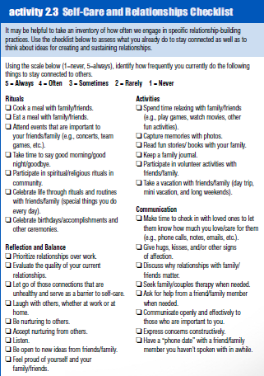
Self-Care and Relationship Checklist
What About You?: A Workbook for Those Who Work with Others, The National Center on Family Homelessness. 2008.
http://508.center4si.com/SelfCareforCareGivers.pdf
Notes:
Notes to Trainer: Ask the participants to take out and review hand out. After asking them to do a quick review of the list ask if there are any ways they take care of themselves that are not on the list. This is a good example of a tool that you can bring back and do with colleagues.
Katherine T. Volk, Kathleen Guarino, Megan Edson Grandin, and Rose Clervil. What About You?: A Workbook for Those Who Work with Others, Copyright 2008: The National Center on Family Homelessness. Available at: www.familyhomelessness.org/media/94.pdf

Slide 15
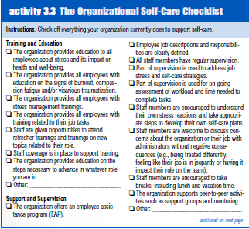
Organizational Self-Care Check List
Like the self resiliency exercise, this organizational exercise helps supervisors and programs measure how well they are doing helping serve their clients.
What About You?: A Workbook for Those Who Work with Others, The National Center on Family Homelessness. 2008.
http://508.center4si.com/SelfCareforCareGivers.pdf
Notes:
Notes to Trainer: This instrument is designed to help agencies create trauma-informed, supportive work environments. It includes a checklist format for organizations to evaluate:
Training and education
Support and supervision
Communication
Employee control and input
Work environment
It also includes a self–assessment handout for employees.
What About You?: A Workbook for Those Who Work with Others, Katherine T. Volk, Kathleen Guarino, Megan Edson Grandin, and Rose Clervil, Copyright 2008: The National Center on Family Homelessness http://www.familyhomelessness.org/media/94.pdf (p.36-37)

Slide 16
Changing the landscape of trauma begins with us.
Mindfulness based stress reduction for health care providers and patients has been studied for 35 years
Notes:
http://www.umassmed.edu/cfm/stress-reduction/history-of-mbsr/

Slide 17
Stressful work environment—how does it manifest itself with staff?

Slide 18
Nursing Workplace Examples:
Poorer health due to stress reactivity (immune, autonomic, nervous system, and endocrine system)
High blood pressure
Lack of work satisfaction
Impacts staff retention/costs to health system
Absenteeism
Inability to concentrate

Slide 19
Mindfulness Based Intervention (MBI): To Increase Resiliency and Work Engagement
Intervention Arm
40% reduction in stress hormones
Significant difference in Breaths/30sec
Significant increase in work engagement, vigor, and dedication (Utrecht scale)
Increase in resiliency scores (Connor-Davidson Resiliency Scale)
Improved job satisfaction scores
(Klatt et al., 2015)
Notes:
Mindfullness in Motion (MIM): An Onsite
J Vis Exp. 2015; (101) 52359

Slide 20
Building Resiliency With Co-Workers
Name It and Write It Down:
Three good things about a co-worker
Three good things about your most recent client
Three good things about yourself
One positive thing you can do this week to take care of yourself
(Adapted from Linda Graham, 2013)
Notes:
Notes to Trainer: Tell participants they can use adjectives. If participants don’t see clients, then ask them to write down three good things about their staff.
During debrief, ask the audience which question was the hardest to answer. Did any of participants write down three good things about their co-worker in the room? Ask them if they would be willing to share what they wrote about their colleague. Ask the colleague how it felt to hear that about themselves. Ask if this process would make it easier for them to come up with three good things about themselves.
Ask participants, why did we do this exercise? Explain that it is because we often forget to model for ourselves what is so important to do with clients. It’s important to take time to care for and value each other and ourselves. When we visit clients it’s incredibly important to remember that we may be the only person who compliments her—especially if she is experiencing domestic violence.
Lastly, this concept lends itself to a simple action that other programs have started doing. What if each week everyone wrote one good thing about each of their coworkers on sticky note and left it on their coworkers’ desks? Ask them how many of them keep nice things supervisors, staff or clients wrote to them (ask for show of hands). It made them feel good or cheered them up on a bad day. What if we felt good every week rather than just occasionally?
Inspired and adapted from exercises in: Bouncing Back: Rewiring Your Brain for Maximum Resilience and Well-Being by Linda Graham (2013)

Slide 21
Simple Steps to Organizational Self Care
Weekly (if possible) staff check in
Staff check in that begins with ALL staff writing down three positive things about clients and colleagues
Share a few positives before debrief of difficult cases
Share a few more positives after the difficult cases
It’s all about how it ends!
Notes:
Notes to Trainer: Our recommendation is that every program have all client visits completed by 3:30 pm in the afternoon on Friday and they hold that time sacred for debriefing their caseloads and difficult cases and continuing quality improvement for their organizational self care practice.
The three positives could be cool things that made a difference in your week, that you heard about with co-workers or that you experienced with clients.
This kind of trauma informed organizational practice lends itself to reducing compassion fatigue and burn out and increasing staff retention. This kind of programming can increase productivity and can help a system save money by reducing the number of unplanned mental health days staff take.

Slide 22
Mindful Practices helps people to slow down, become self-aware, and present in the moment. We start with you so you can help clients.
Stand or remain seated
Lift arms toward the ceiling while taking deep breath in and then reach higher
Exhale while you bring your arms down
Repeat sequence four times
“Does anything feel different now?”
We will do this at the end of every module

Slide 23
Online IPV toolkit for health providers and advocates
www.ipvhealth.org
www.ipvhealthpartners.org
Notes:
Notes to Trainer:
Futures Without Violence Online toolkit that has links to FUTURES resources, videos and other national resources. www.healthcaresaboutipv.org

