Slide 1
Preventing and Responding to Intimate Partner Violence: A Tool for Providers
Notes:
Estimated Total Training Time: 5 hours and 30 minutes
(Depending on the amount of discussion time and activities)
Notes to Trainer: There are many variables that influence the length of this training, including the familiarity of the Trainer with the material, the size of the audience, and the time allowed for discussion and activities. It is important to include elements of interactivity (group discussion, video vignettes, role plays, etc.) for optimal adult learning and to avoid overloading the participants with didactic material. We suggest that you schedule AT LEAST 1 break during the training, with an opportunity to stretch, eat, and socialize. Remember that this is difficult content and participants will need a “breather.”

Slide 2
“
Research shows us that violence is both a significant cause and a significant consequence of HIV infection among women.
Judy Auerbach
American Foundation for AIDS Research (AmfAR)
“

Slide 3
Statistics: HIV + IPV
Women and girls who are victims of GBV are 4 times more likely to become infected with STIs including HIV.
Women who were beaten or dominated by their partners were 48% more likely to become infected with HIV than women in non-violent relationships.
(Decker et al, 2009; Gielen et al, 2007; Decker et al, 2005; Wingood et al, 2000; Campbell &Soeken, 1999)
Notes:
Dunkle, Kristin L. et al., 2004
Decker et al, 2009; Decker et al, 2005
Gielen, A.C., et al. (2007). HIV/AIDS and intimate partner violence: intersecting women’s health issues in the United States. Trauma, Violence, & Abuse. 8(2):178-198
Wingood, G.M., R.J. DiClemente, and A. Raj. (2000a). Adverse consequences of intimate partner abuse among women in nonurban domestic violence shelters. American Journal of Preventive Medicine 19(4):270-275.
Wingood, G.M., R.J. DiClemente, and A.Raj. (2000b).Identifying the prevalence and correlates of STDs among women residing in rural domestic violence shelters. Women and Health 30(4):15-26.
Campbell, J.C., and K. Soeken. (1999). Forced sex and intimate partner violence: Effects on women’s health. Violence Against Women. 5:1017-1035.

Slide 4
Statistics: HIV + IPV
Among a sample of HIV-positive men:
39% reported physical violence by a primary sexual partner
17% reported physical violence by a casual sexual partner
Shelton et al, 2005
Notes:
This study by Shelton and colleagues examined the prevalence of physical IPV in a convenience sample of HIV-infected men (n=54) who were recruited from HIV support groups. The majority of the sample were African-American (69%) and were over the age of 30 (85%). Eighty percent reported their sexual identity as gay or bisexual. Physical IPV was defined as having ever been hit by an intimate partner.

Slide 5
Addressing the Barriers: CUES universal education approach
C: Confidentiality: Disclose limits of confidentiality & see patient alone
UE: Universal Education:
Normalize activity: "I've started giving info on IPV to all of my patients”
Make the connection: Open the card and do a quick review: "It talks about healthy and safe relationships…and how relationships affect your health“
S: Support: - Create a sense of empowerment:
“we give this to everyone so they know how to get help for themselves or so they can help a friend or family member…”
Notes:
“You can use the FUTURES safety card to do this intervention because it has helpful questions to prompt conversation, but you can also use any brochure of IPV/SA to use as a conversation starter and a resource that the patient can take with them. This approach is evidence based.”
Using a universal education approach is an evidence based strategy for responding to domestic and sexual violence (ADD CITATION)
CUES – may help you remember the steps:
C: disclose limits of confidentiality-always review limits of confidentiality with patients prior to any assessment
U: Universal Education
S: Support - give every patient support and referrals – regardless of disclosure
Remember, patients may or may not goal is NOT disclosure.
Screening w/o response is ineffective
(Feder et al. 2014)
Survivors often chose not to disclose
Not ready, distrust of formal systems, limited resources, fear of retaliation, CPS
For example, in FP study 50% women disclosed in study – but only 10% to trained providers
Universal education provides an opportunity for primary, secondary and tertiary prevention

Slide 6
New Provider Tool
New Safety Card for Providers!
Addresses the intersection of HIV and violence.
Starts the conversation and makes universal education easier
Includes resources for survivors and persons recently diagnosed with HIV or STIs

Slide 7
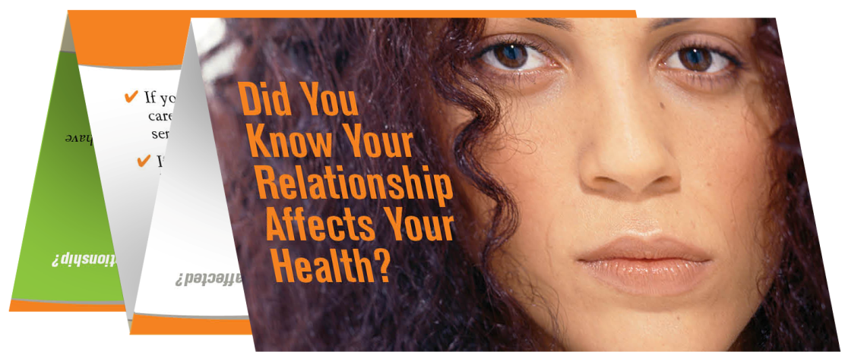
Evidence Based Interventions
Reproductive coercion intervention: decreased pregnancies and increased independence from abusive relationships
Adolescent relationship abuse intervention: decreased incidents of dating violence.
Both interventions:
Increased knowledge of local IPV/SV resources
Clients indicated high likelihood of sharing with friends/family
Clients appreciated the opportunity to discuss relationship safety with providers

Slide 14
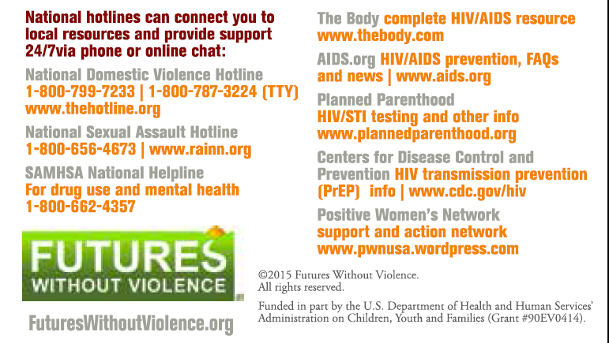

Slide 15
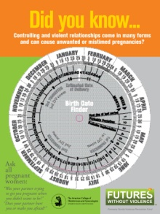
National Health Resource Center on Domestic Violence
For free technical assistance and tools including:
Safety cards
Training curricula
Clinical guidelines
State reporting law information
Documentation tools
Pregnancy wheels
Posters
www.futureswithoutviolence.org and www.healthcaresaboutipv.org
Notes:
Narration: The National Health Resource Center on Domestic Violence provides free technical assistance and health materials.
To order materials, visit: https://secure3.convio.net/fvpf/site/Ecommerce/15587835?FOLDER=0&store_id=1241

Slide 16
Currently piloting these materials
“Sex, Relationships and Getting Tested” Safety Card
Provider training curriculum on intersection of IPV/SV and HIV.
Please get in touch with questions or comments!
Kate Vander Tuig
kvandertuig@futureswithoutviolence.org

Slide 17
Thank you to our collaborators!
Notes:
Erin Falvey at Christie’s Place
Michele Decker at John Hopkins
Eddy Machtinger at UCSF’s Women’s HIV Program

Slide 18
Looking forward to upcoming materials…
Safety Cards for LGBTQ and Trans/Gender Non-Conforming survivors
LGBTQ Poster

